Slide 1

DONALD TRUMP Keep America Great
Foundation project -1 , Group 1
Abhilash Gadepalli
Aparna Sharma
Debjit Ray
Divyansh Saxena
Raj Sandeep Yennisetty

Slide 2

Team
Abhilash Gadepalli
Aparna Sharma
Raj Sandeep Yennisetty
Debjit Ray
Divyansh Saxena

Slide 3



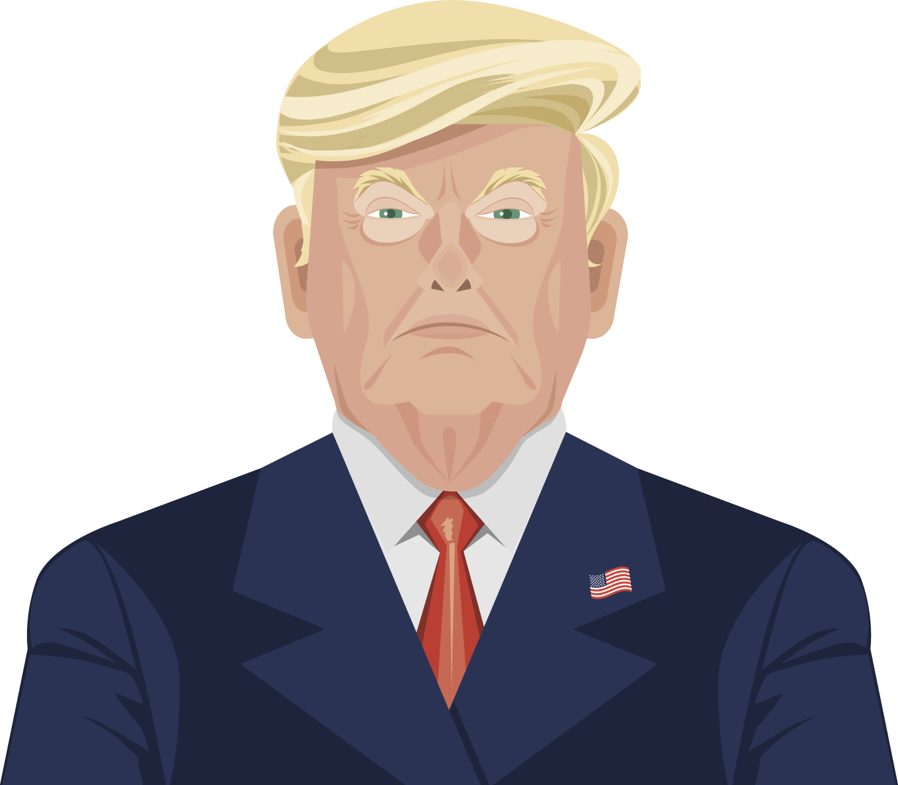

Donald Trump
88.9M Followers
34.7M Followers
23M Followers
Famous and Colorful Billionaire
45th US President

Slide 4



2 months pre election and 2 months post election Tweets.
Transcripts from YouTube videos
News Articles from print media

Slide 5



Process the data using Text Analytics.
TEXT-BLOB Library
Bag of Words
Spell Check
Sentiment Analysis

Slide 6
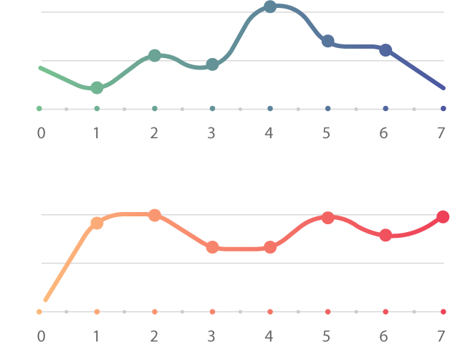
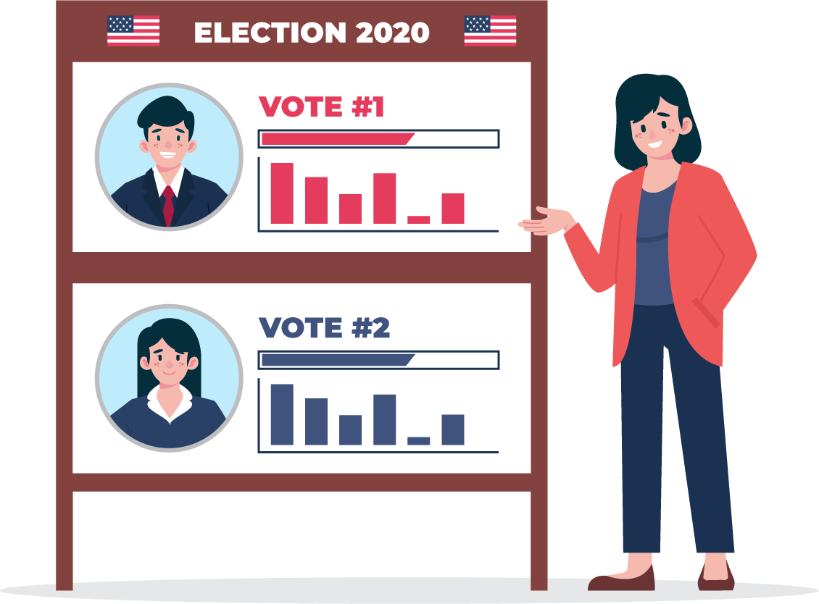
Apply Statistics to predict Trump’s popularity using TA output
VS

Slide 7

Did his fan base help Trump to influence elections? Let’s find out.

Slide 8
INPUT DATA SOURCES

Slide 9
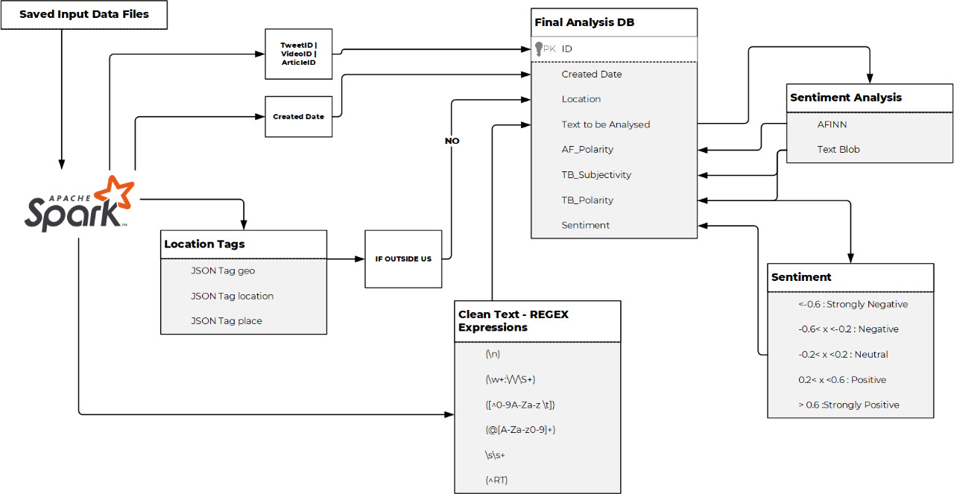
TEXT ANALYTICS

Slide 10
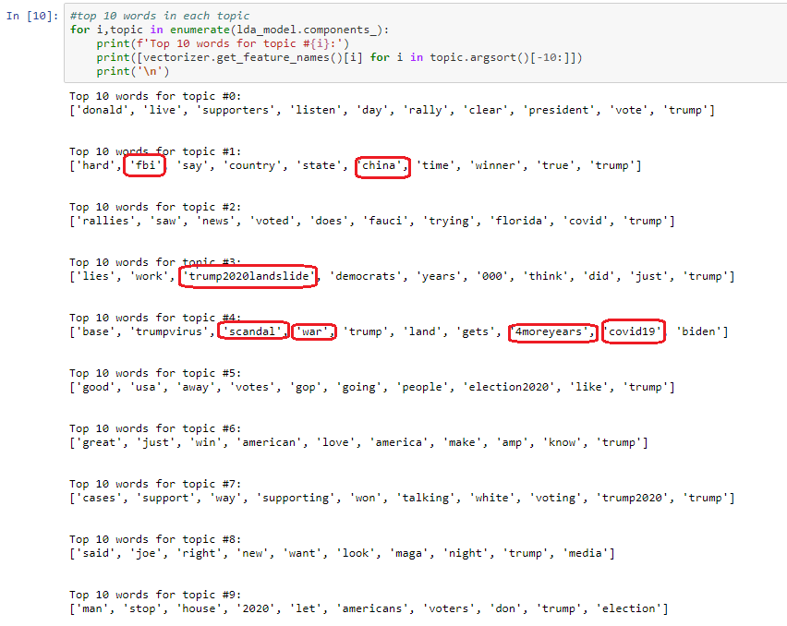
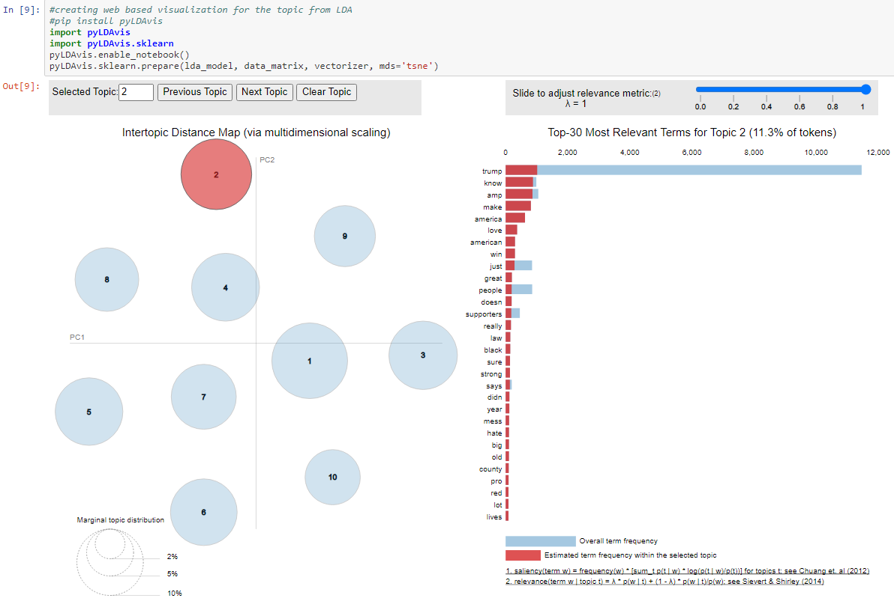
Insights: Topic Modelling - LDA (US Tweets)

Slide 11
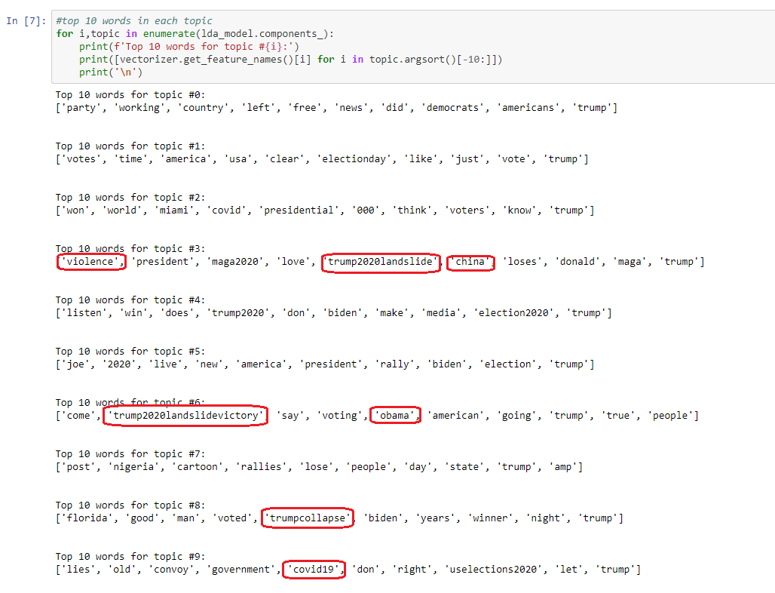
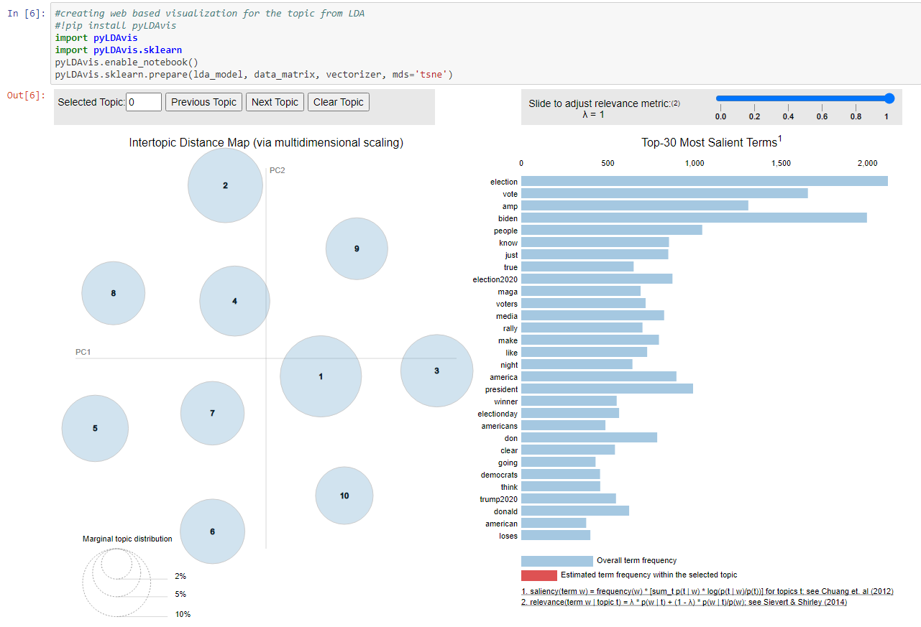
ADDITIONAL INSIGHTS – LDA, Topic Modelling & Google Trends (Non US Tweets)

Slide 12
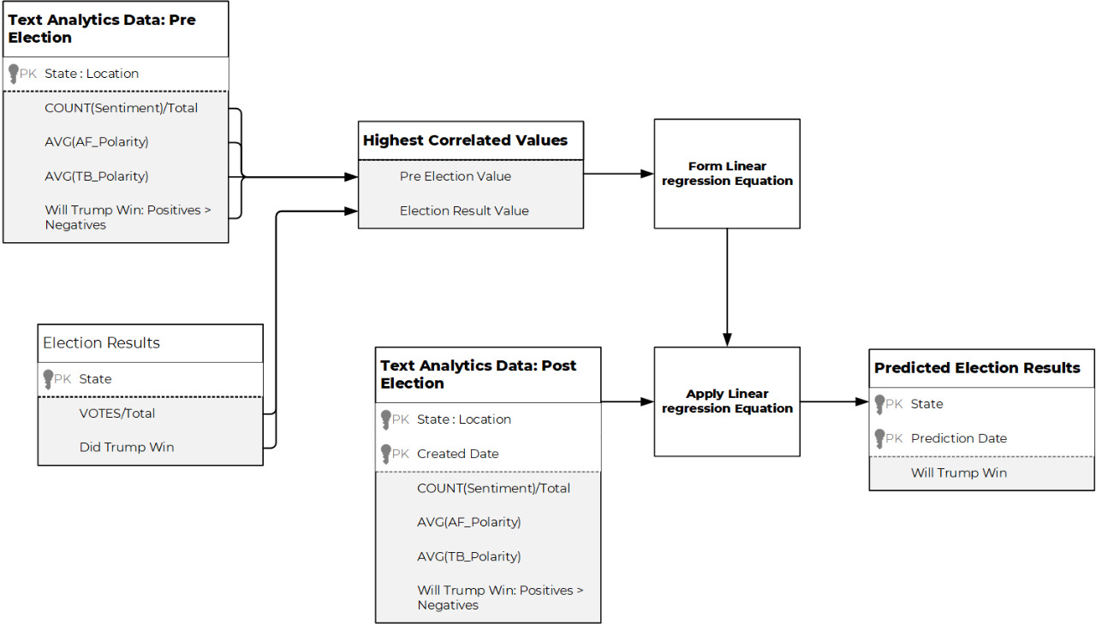
THE TEST

Slide 13
CORRELATION VALUES
AVG(TB_Polarity) vs Vote Proportion | 0.13999304
AVG(AF_Polarity) vs Vote Proportion | 0.384450164
COUNT(Strongly Negative + Negative) vs Vote Proportion | -0.176324167
COUNT(Strongly Positive + Positive) vs Vote Proportion | 0.09792169
The Chi-Square Test done on all the above values also gives very high P-Values
Thus establishing independence between the variables
THE RESULT
ISSUES FACED
Small Sample Size on Pre Election Dates due to limitations of Full Archive mode of Twitter API
High Amounts of neutral sentiment scores due to limitations of lexicons
Ambiguity and Indistinctness leads to LDA instability
Emoticons in Text were unhandled by chosen library
US Election results are calculated by COUNTY and not by STATE yet our location data only had information until state
Location Data extracted by us was not reliable enough
Online Posting can be done by people not on Actual Voters List

Slide 14
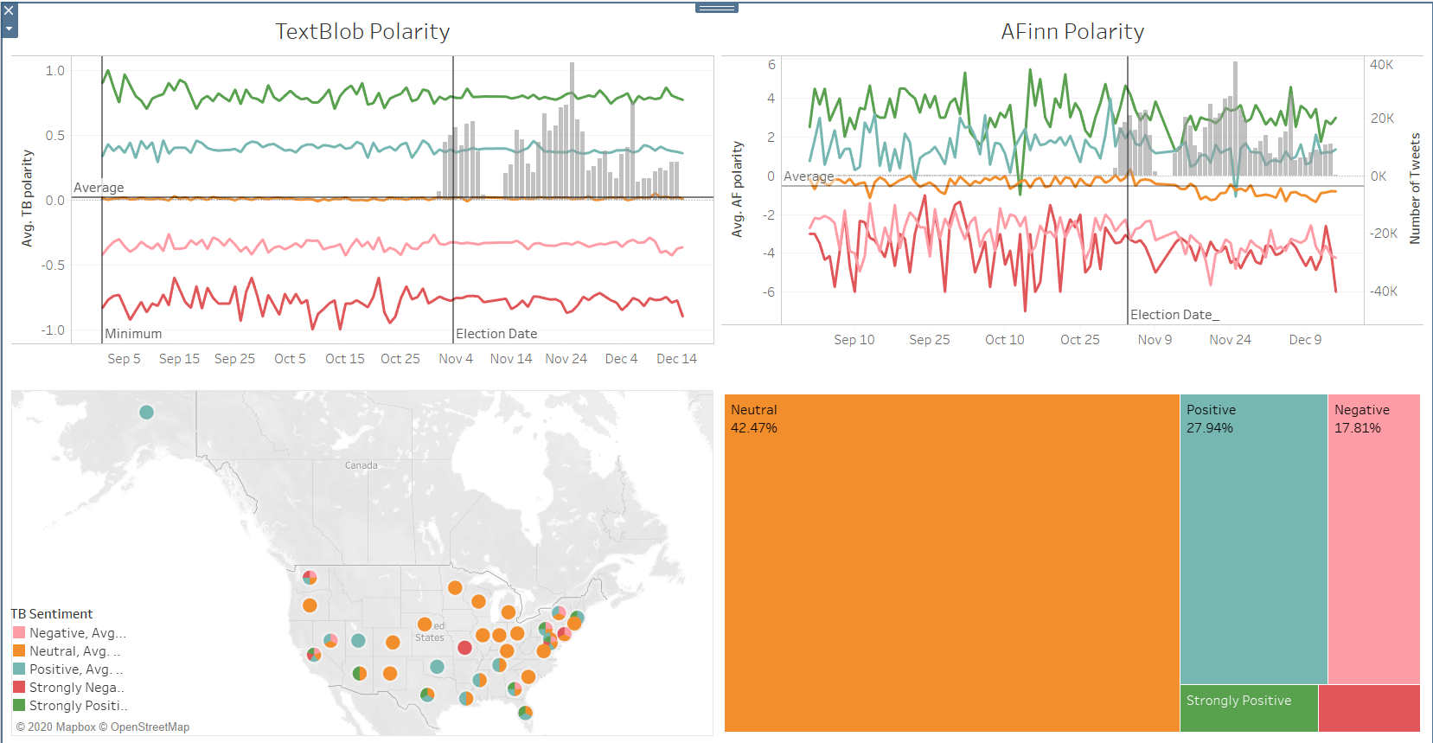
DASHBOARD CREATED – US TWEETS

Slide 15
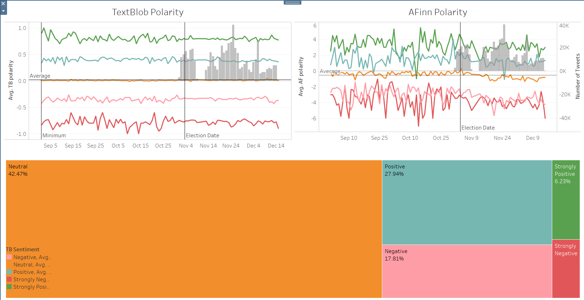
DASHBOARD CREATED – Non US TWEETS

Slide 16
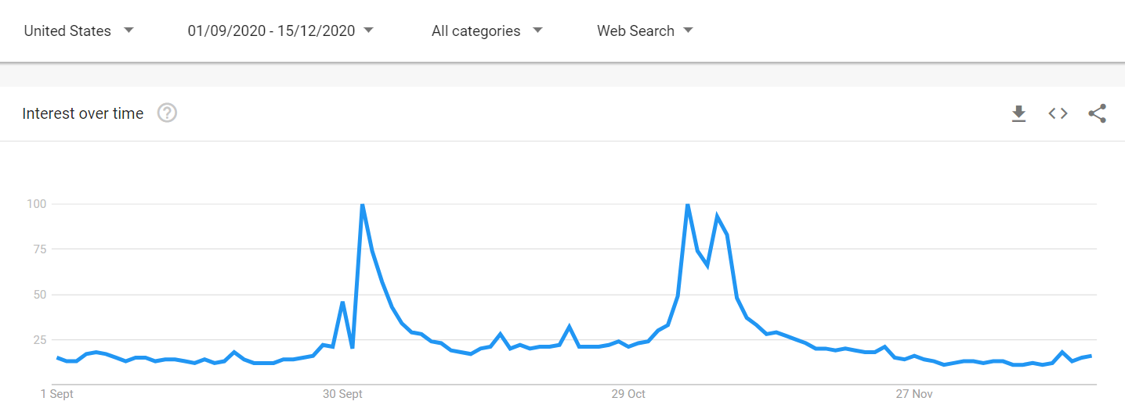
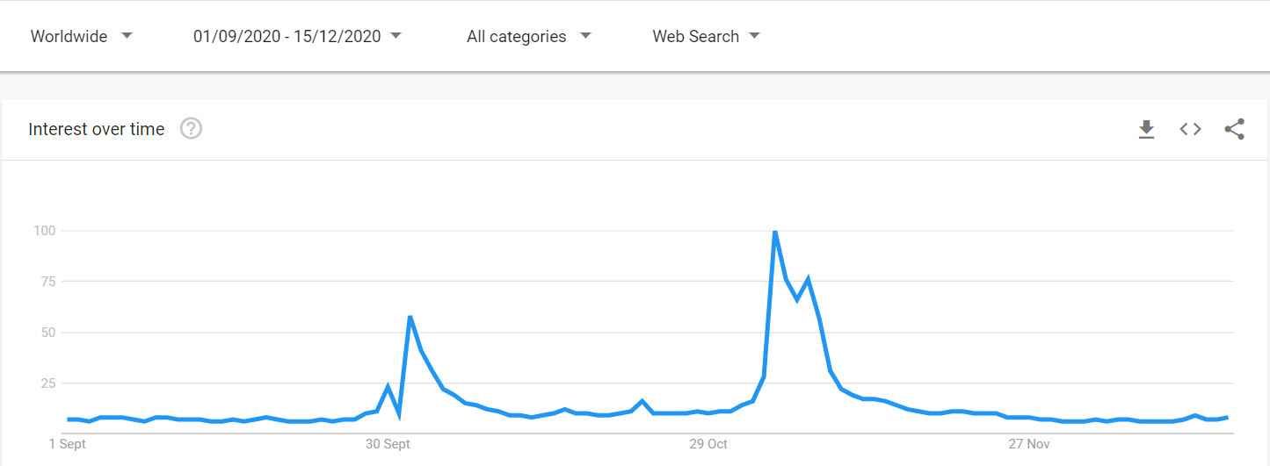
INFERENCE
Overall Polarity and Sentiment scores in Positive indicate
Either, more Trump supporters are active on Twitter
Or, the Twitter sample data received was skewed
Or, the TextBlob lexicon¹ used to determine polarity is not the ideal choice
The tweet volume and Google trends show spikes on similar dates:
Around Nov 3rd – Being the US Election date, the spike is understandable
Around Nov 14th to Nov 26th – Trumps’ actions post election has caused a lot of reactions on social media.
Post election, the polarity score on tweets, show a decline. This again can be attributed to the negative reactions on Trumps’ actions post election. Given this, if US was to go to election today, we can conclude with higher confidence that the results would not have been in support of Trump.
The sample tweet count for states like North Dakota and Wyoming for pre-election period was low (23 and 30 respectively). Similarly, for post election period the number of tweets were 308 and 312 respectively. These indicate:
Either very few people from these states are active on Twitter
Or, the location for people belonging to these states have not updated the location on Twitter.
¹ https://www.aclweb.org/anthology/R15-1064.pdf

Slide 17
THANK YOU

